Slide 1
DATABASE AND CHARACTERSTICS
System Design(SD)(22CS024)
Bachelor of Engineering- Computer Science & Engineering
Department of Computer Science & Engineering
Chitkara University Institute of Engineering and Technology, Chitkara University, Punjab, India

Slide 2
What is Database?
Data refers to raw, unorganized facts and figures, such as numbers, text, images, or symbols, that can be processed and analyzed to extract meaningful information
Data can exist in a raw form (unorganized) or processed form (organized and meaningful).
A database is a structured collection of data designed for efficient storage, retrieval and manipulation.
It serves as a centralized repository, allowing data to be accessed, managed, and updated by multiple users or applications

Slide 3
WHY DATABASE??
Drawbacks of Traditional File Systems
Distinguished and Isolated Data
Data Duplication / Data Redundancy
Dependence on Data
Data representation is challenging from the user's perspective
Different file types
Data Protection
Issues with Transactions
Concurrent issues

Slide 4
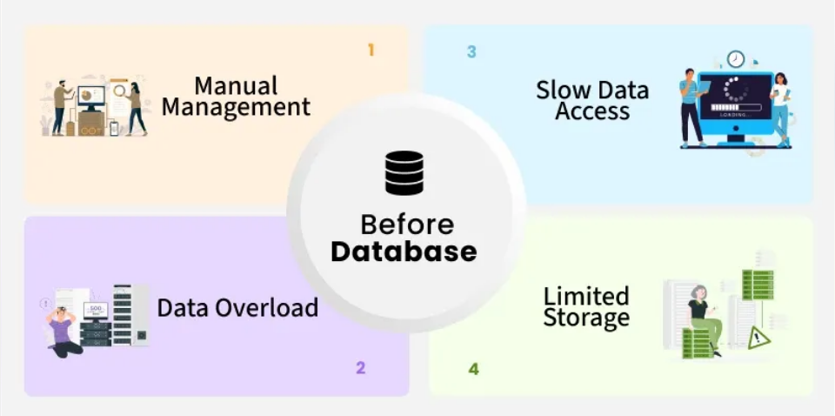
Summarized Issues with TFS

Slide 5
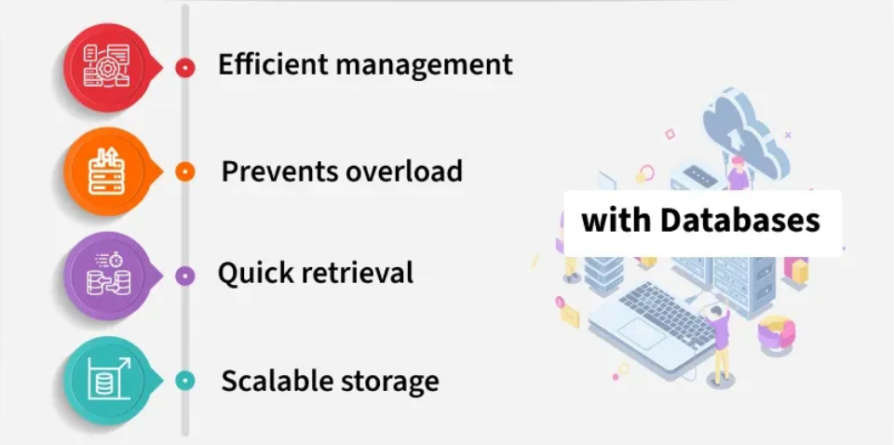
Essential Characteristics of Database

Slide 6
Essential Characteristics of Database
A high-performing database is vital for any organization, supporting operations, customer interactions and systems like digital libraries, reservations, and inventory management. Databases are essential because they:
Scale efficiently to handle massive volumes of data.
Ensure data integrity through built-in rules and constraints.
Protect data with secure access controls and compliance support.
Enable analytics by identifying trends and guiding informed business decisions.

Slide 7
Working of Databases
Databases work by organizing and storing information in a structured or unstructured format, allowing easy access, retrieval, and modification.
The DBMS handles tasks like querying, updating, deleting and managing access permissions, without requiring users to know the physical details of where data is stored.
When a user submits a request (such as a search or update), the DBMS processes the query, locates the relevant data, and returns results in a structured format.
DBMSs provide features like backup, recovery, performance optimization and data security to ensure the system runs efficiently and reliably.

Slide 8
Components of a Database
Data: The actual information stored in the database, such as text, numbers, images, or files.
Schema: The structural blueprint that defines how data is organized—tables, fields, data types, and relationships.
DBMS: The software that manages database operations like storage, retrieval, and security (e.g., MySQL, Oracle).
Queries: Instructions (usually SQL) used to retrieve or manipulate data within the database.
Users: People or systems that interact with the database, each with specific roles and access permissions.

Slide 9
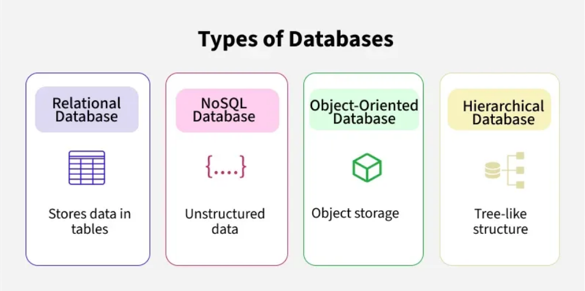
Types of Databases

Slide 10
Types of Databases
Relational Databases (RDBMS)
These databases organize data into tables made up of rows (records) and columns (fields). Each table stores related information (like customers, products, or orders), and tables can be linked using keys (Primary and Foreign Keys).
Examples: MySQL, PostgreSQL, Oracle, Microsoft SQL Server.
Why Use It: Easy to use, highly consistent, and supports powerful querying with SQL.

Slide 11
Types of Databases
NoSQL Databases
"NoSQL" stands for "Not Only SQL". These databases are designed to handle unstructured or semi-structured data, such as text, images, videos, or sensor data. They don’t rely on the traditional table format. Instead, they store data in formats like:
Document-based (e.g., MongoDB),
Key-value pairs (e.g., Redis),
Wide-column (e.g., Cassandra),
Graphs (e.g., Neo4j).

Slide 12
Types of Databases
Cloud Databases
These databases run on cloud platforms instead of local servers. They offer on-demand scalability, reduced maintenance, and high availability. You pay for what you use and can access them from anywhere.
Examples: Amazon RDS, Google Cloud SQL, Azure SQL Database.
Why Use It: Automatic backups, easy to scale, and no need for in-house hardware.

Slide 13
Types of Databases
Graph Databases
These databases focus on how data relates to other data. They use a structure of nodes (data points) and edges (relationships) to represent and store data.
Examples: Neo4j, Amazon Neptune.
Why Use It: Great at managing relationships, faster for queries involving connected data.

Slide 14
Types of Databases
Distributed Databases
A distributed database stores data across multiple locations—which can be on different computers, data centers, or even continents. Despite being spread out, it works as a single database system to the user.
Examples: Apache Cassandra, Google Spanner.
Why Use It: Improves speed and availability, ensures fault tolerance, and reduces the risk of system failure.

Slide 15
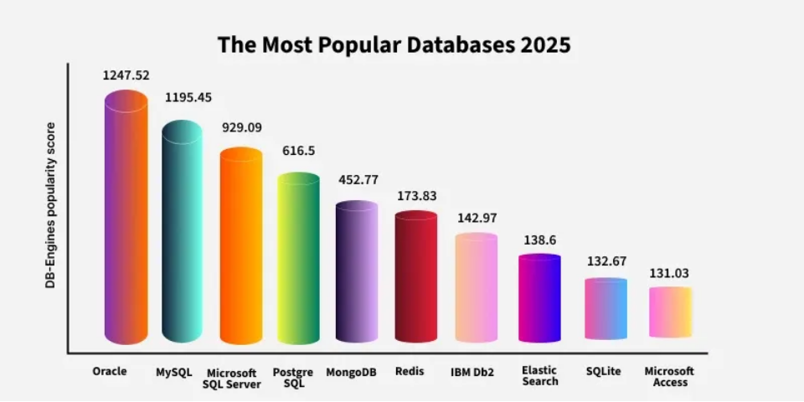
Types of Databases

Slide 16
THANK YOU

